Slide 1


Exploring Hotel Booking Trends

Slide 2



Problem Statement
Understanding key patterns in hotel booking behaviors (e.g., ADR trends, lead times, and customer segments) to optimize pricing strategies, improve customer experience, and enhance operational efficiency.
Challenges:
Variability in customer behavior across market segments and booking channels.
Fluctuations in bookings and ADR influenced by seasonality and external factors.

Slide 3

Motivation
Why This Problem Matters:
Hotels aim to optimize revenue while ensuring customer satisfaction. Customer behaviors vary greatly across segments (e.g., corporate, group, transient), making one-size-fits-all strategies ineffective.
Understanding these behaviors provides insights for smarter pricing, marketing, and resource allocation decisions.
Challenges in Solving This Problem:
Numerous factors, such as lead times, market segments, and seasonality, influence booking trends.
Large datasets with complex relationships require sophisticated analytical approaches to extract meaningful insights.

Slide 4
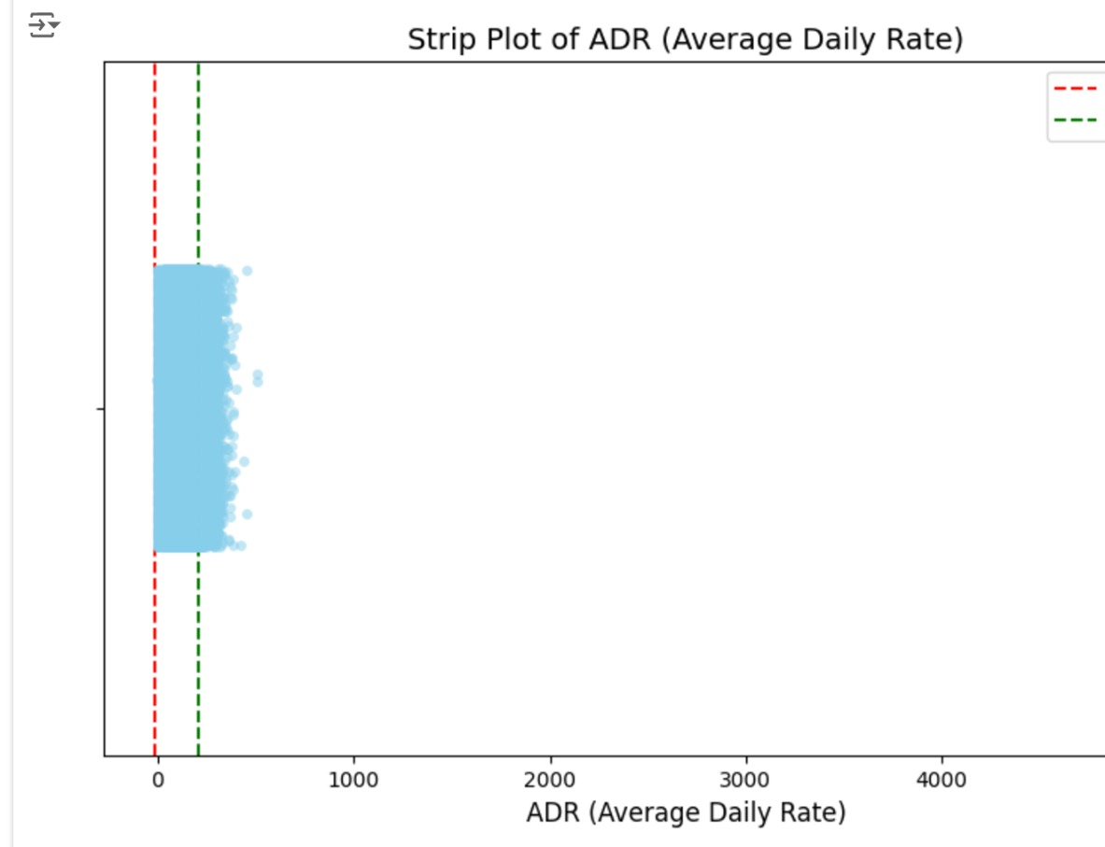
Approach
Data Preparation
Exploratory Data Analysis (EDA)
Visualization Tools
Key Metrics

Slide 5
FUTURE WORK
Incorporating external factors (e.g., weather, holidays) to improve insights.
Developing machine learning models for predicting cancellations and booking trends.
Introducing real-time dashboards for dynamic pricing and operational adjustments.
Expanding the analysis to include multiple hotels or chains for broader insights.

Slide 6


Thank you

